Slide 1
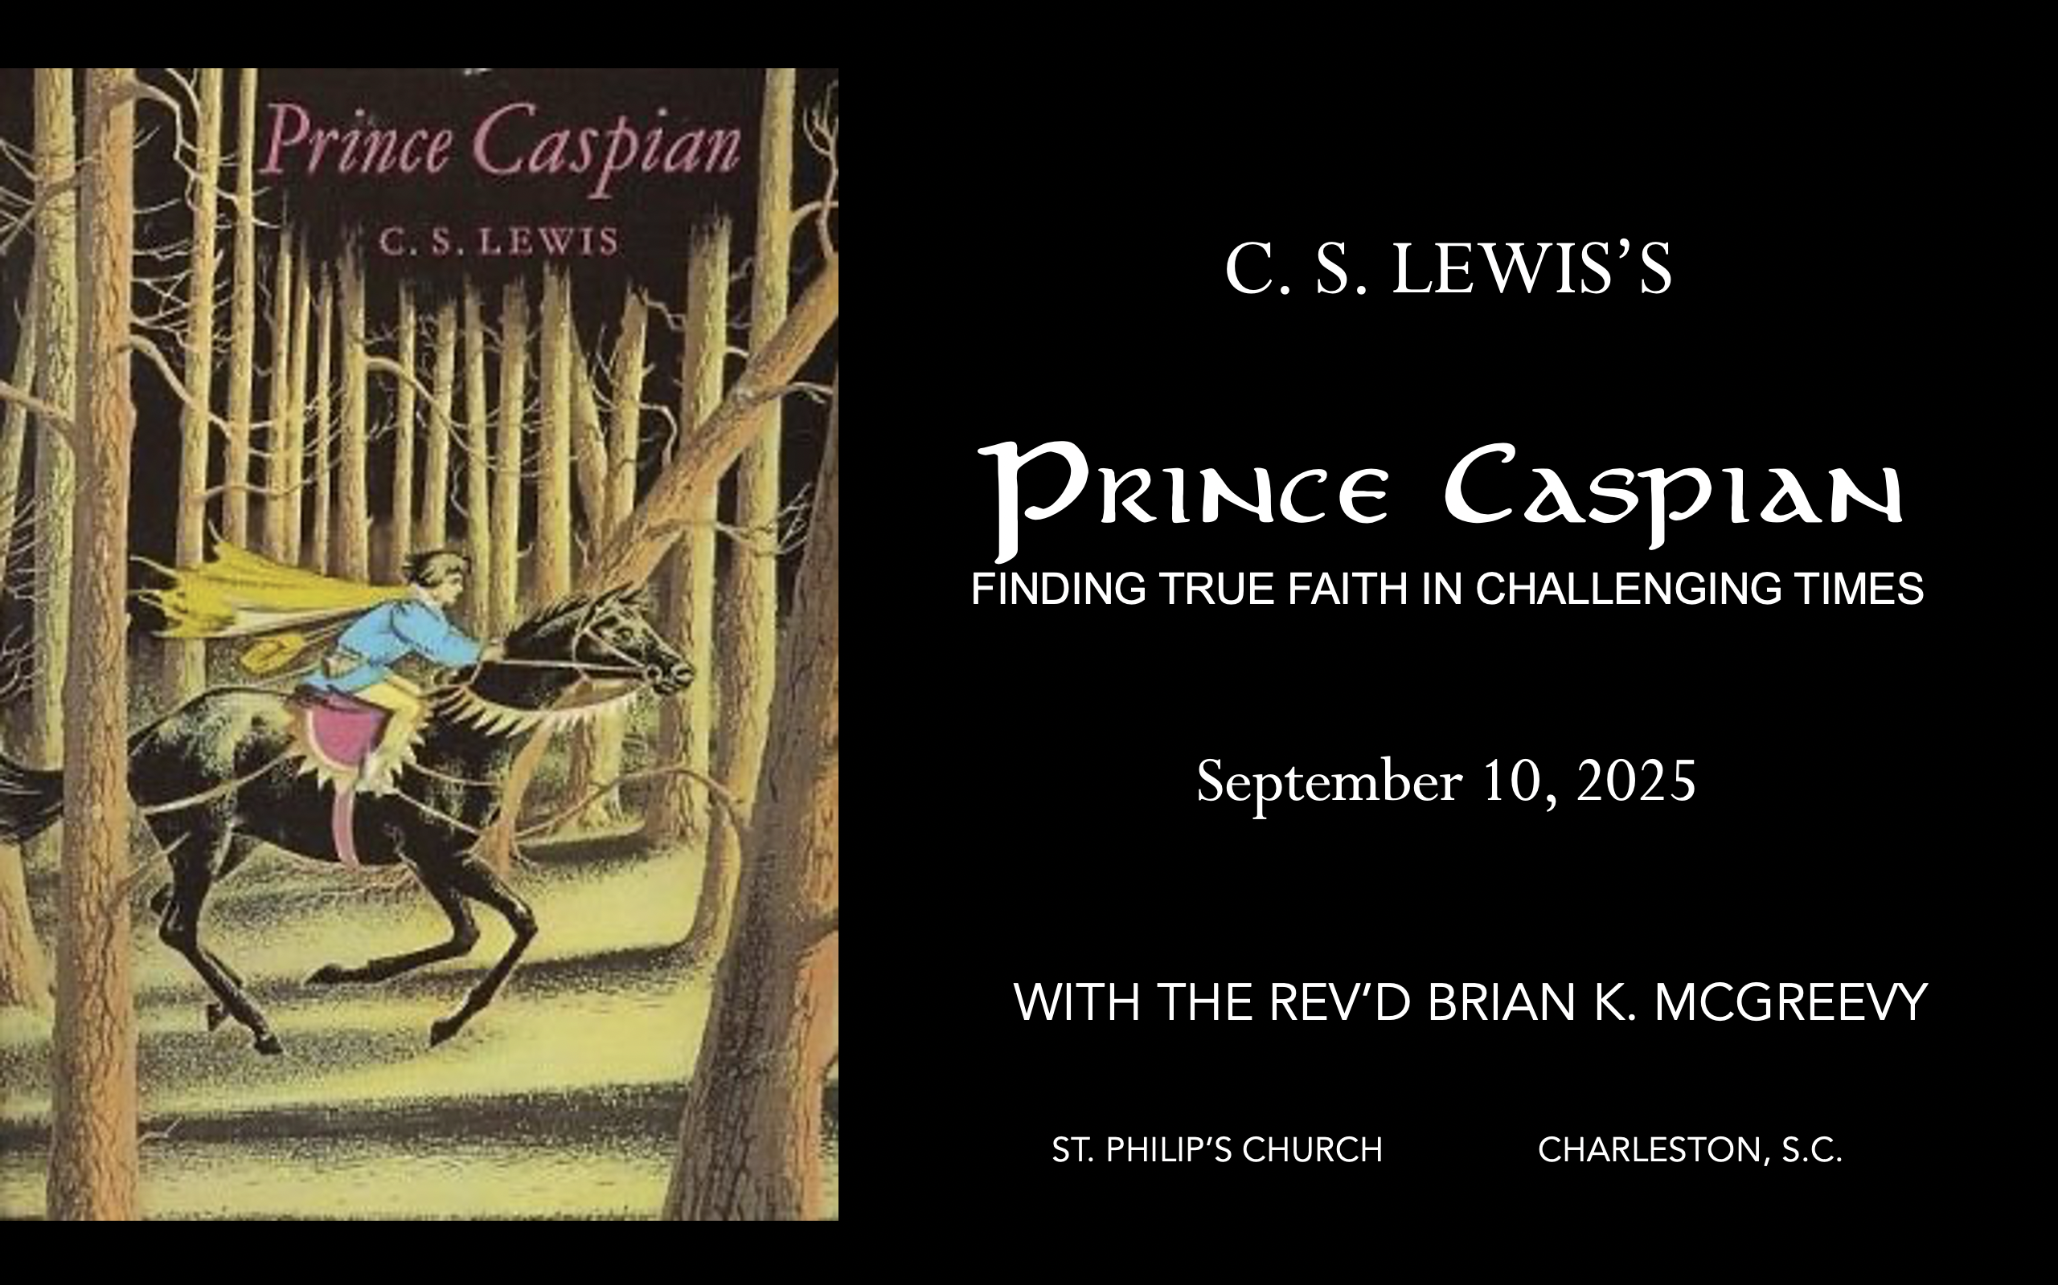


September 24, 2025
October 1, 2025
October 8, 2025
October 15, 2025
October 22, 2025

Slide 2
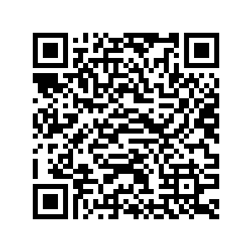
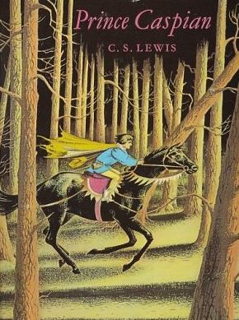
How to approach this class: How to approach this class:
--On the beach --Snorkeling --Scuba diving --Email list/QR code How to read this book: --Try reading aloud and slowly, looking for layers of meaning
--Look for themes/underline and highlight passages that resonate with you
What we’ll be doing:
--Setting the background and context
--Following the story chapter by chapter
--Drawing out principles for living with Joy and Purpose
--Looking at relevant Scripture

Slide 3
For you were once darkness, but now you are light in the Lord. Live as children of light (for the fruit of the light consists in all goodness, righteousness, and truth), and find out what pleases the Lord.
Have nothing to do with the fruitless deeds of darkness, but rather expose them. It is shameful even to mention what the disobedient do in secret. But everything exposed by the light becomes visible—and everything that is illuminated becomes a light. This is why it is said: “Wake up, sleeper, rise from the dead, and Christ will shine on you.” Be very careful, then, how you live— not as unwise but as wise, making the most of every opportunity because the days are evil.
Ephesians 5:8-15

Slide 4
Why Narnia matters SO much today Aggressively secular narrative pervading our culture—how to counter?
Which Story Can We Trust? Either
We are here by accident, meaningless products of a random process. We create our own identity and can only invent meaning and purpose in life and do our best to stay alive—even though there is no point to life. Sartre, Dawkins, Nietzsche, most schools OR
We are precious creatures made by and in the image of a loving God, who has created us for something special that we are asked to do. We have the privilege of being able to do good and experience purpose as we live by faith in Christ in His Kingdom. The witness of Scripture, the Church, and the saints
These two stories are totally incompatible. They can’t both be right: cognitive dissonance. So which do we trust? Other stories, like the Chronicles of Narnia, can help us here by highlighting dissonance or by creating a narrative we want to inhabit. So which do we trust? Is Jadis really the Queen of the realm of Queen Narnia? OR Is she the White Witch, a usurper in Narnia, which is really the realm of the mysterious great and noble lion, Aslan? Gradually, one story about Narnia emerges as supremely plausible, as each individual story turns out to be part of this greater narrative. This grand narrative of interlocking stories makes sense of the riddles the children see and experience and reveals the character of each narrative. These stories teach that Biblical truth and the wisdom of the world cannot both be True---we need to learn to think critically because we are surrounded by falsehood.
We each have our unique story. But our own story needs to be brought into connection with a grand narrative, a big story which gives our story a new importance and significance. Why? Because we realize that our story is framed by something greater which gives us value and purpose. Lewis’s remarkable achievement in Narnia is to allow his readers to inhabit this big story, to get inside it and feel what it is like to be part of it. --Rev. Dr. Alister McGrath, Holder of the Andreas Idreos Chair in Science and Religion, Oxford University (Ph.D. in Molecular Biophysics, Doctor of Divinity in Theology, and Ph.D. in Intellectual History, at Oxford)

Slide 5
Imagination: What Does It Mean to Inhabit a Story
“The shaping of our loves, desires, and imagination thus happens primarily
The Narnia stories are deeply grounded in the Biblical story and its four major scenes of Creation, Fall, Redemption, and New Creation. The White Witch, Miraz, and other evil characters in the Narnia stories are all engaged in the evil enchantment of encouraging a
Disciplined Forgetting of Aslan, his Story, and the Deep Magic.

Slide 6
Why Prince Caspian is especially relevant today
Imagine living in a land
--that had forgotten its history and substituted a revisionist narrative that said all evidences of the Divine were foolish myths,
--where individuals struggled to practice their faith while being surrounded by a sea of doubters and skeptics,
--where Evil seemed poised to triumph over Good, and
-- where even the strongest believers wondered sometimes whether they had been abandoned.
Welcome to the world of Prince Caspian, the next book of the Chronicles of Narnia after The Lion, the Witch, and the Wardrobe. C.S. Lewis wrote that this book concerns the “restoration of the true religion after a corruption.
We will be examining such themes as
--how disbelief and doubt creep into our lives,
--the effects of living under the wrong framework of reality,
--the importance of cultivating virtue and courage, and
--the priority of seeking the Kingdom of God with our whole heart.

Slide 7
Chapter 5: “Caspian’s Adventure in the Mountains” (Firing the imagination—Do we actually get to MEET Caspian? What kind of adventure? Mountains?)
Prince Caspian continues learning more about Old Narnia from Dr. Cornelius and longs after it, in the midst of all his other education.
Caspian’s tutor wakes him in the night and tells him he must prepare to flee; he tells Caspian the whole truth, which is that Caspian is the true King of Narnia and his uncle Miraz a usurper who murdered Caspian’s father. Miraz’s wife has had a baby son, so now Miraz plans to kill Caspian to make way for his own son.
Caspian parts tearfully from Dr. Cornelius, who gives him not only a bag of gold but also the precious magical horn of Queen Susan to be used only in extremity.
Riding his horse Destrier, Caspian heads south into the deep pine forest, when a storm causes the horse to bolt and Caspian is knocked unconscious. He is rescued by a badger and two dwarfs, who are Old Narnians who disagree about what to do with him. Caspian explains his belief in Aslan, and the badger pledges loyalty to Caspian as the true King.
Themes
The more you learn about what is Beautiful and True, the more your heart longs after it.
True love and friendship are expressed in self-sacrifice.
Lies and treachery, once begun, spiral into even more Evil.
Prejudice against groups without knowing individuals can beget violence.
Remembering from the past what is True and what makes for flourishing is important in order to make wise decisions in the present.

Slide 8
Chapter 6: “The People That Lived in Hiding” (Firing the imagination—What people? Hiding where? Hiding from what or from whom?)
Caspian, the badger, and the two dwarfs begin a series of visits to the Old Narnians seeking to recruit them to help Caspian
The bulgy bears and Pattertwig the squirrel join with enthusiasm, and Pattertwig is sent to summon more Old Narnians to a feast and council on Dancing Lawn; the seven brothers, Red Dwarfs, also agree to support Caspian, and they outfit the party with armor and swords
The Black Dwarfs are more reticent but hate Miraz and agree to support Caspian against him, but suggest recruiting some hags and ogres, an idea from which the company recoils in horror
The centaurs are expecting them, and say the portents of the stars say it is time for war, an idea the company embraces after some consideration
Reepicheep and his mice brethren support Caspian, and although they are unable to wake the trees, a host of Fauns come in the night and lead the company in a dance
THEMES
There is Joy in living into and pursuing your faith
Seeing the same Truth/engaging the same quest is a strong foundation for friendship
A utilitarian/pragmatic worldview is antithetical to fellowship and loyalty
Reductionistic thinking and failure of imagination limits your understanding of reality
The timing and season for a quest is determined in the Heavens

Slide 9
Caspian, the badger, and the two dwarfs begin a series of visits to the Old Narnians seeking to recruit them to help Caspian.
“Now began the happiest times that Caspian had ever known. On a fine summer morning when the dew lay on the grass he set off with the Badger and the two Dwarfs, up through the forest to a high saddle in the mountains and down onto their sunny southern slopes where one looked across the green wolds of Archenland.”
The bulgy bears and Pattertwig the squirrel join with enthusiasm, and Pattertwig is sent to summon more Old Narnians to a feast and council on Dancing Lawn; the seven brothers, Red Dwarfs, also agree to support Caspian, and they outfit the party with armor and swords.
“We will go first to the Three Bulgy Bears,” said Trumpkin. They came in a glade to an old hollow oak tree covered with moss, and Trufflehunter tapped with his paw three times on the trunk;…out came three brown bears, very bulgy indeed and blinking their little eyes. And when everything had been explained to them (which took a long time because they were so sleepy) they said, just as Trufflehunter had said, that a son of Adam ought to be King of Narnia and all kissed Caspian—very wet, snuffly kisses they were—and offered him some honey…[Pattertwig the Squirrel welcomed Caspian at once and asked… if he could take any messages to other friends. “For I can go nearly everywhere without setting foot to ground,” he said. Trufflehunter and the Dwarfs thought this a very good idea and gave Pattertwig messages to all sorts of people with queer names telling them all to come to a feast and council on Dancing Lawn at midnight three nights ahead. Their next visit was to the Seven Brothers of Shuddering Wood… It took some time to satisfy them that Caspian was a friend and not an enemy, but when they did, they all cried—“Long live the King,” and their gifts were noble—mail shirts and helmets and swords for Caspian and Trumpkin and Nikabrik.

Slide 10
The Black Dwarfs are more reticent but hate Miraz and agree to support Caspian against him, but suggest recruiting some hags and ogres, an idea from which the company recoils in horror.
“Five Black Dwarfs…looked suspiciously at Caspian, but in the end the eldest of them said, “If he is against Miraz, we’ll have him for King.”…“Shall we go farther up for you, up to the crags? There’s an Ogre or two and a Hag that we could introduce you to, up there.” “Certainly not,” said Caspian. “I should think not, indeed,” said Trufflehunter. “We want none of that sort on our side.” Nikabrik disagreed with this, but Trumpkin and the Badger overruled him. It gave Caspian a shock to realize that the horrible creatures out of the old stories, as well as the nice ones, had some descendants in Narnia still. “We should not have Aslan for friend if we brought in that rabble,” said Trufflehunter.
The centaurs are expecting them, and say the portents of the stars say it is time for war, an idea the company embraces after some consideration.
“The great Centaur Glenstorm…was a prophet and a star-gazer and knew what they had come about. “Long live the King,” he cried. “I and my sons are ready for war. When is the battle to be joined?” The time is ripe,” said Glenstorm. “I watch the skies, Badger, for it is mine to watch, as it is yours to remember. Tarva and Alambil have met in the halls of high heaven, and on earth a son of Adam has once more arisen to rule and name the creatures. The hour has struck. Our council at the Dancing Lawn must be a council of war.” He spoke in such a voice that neither Caspian nor the others hesitated for a moment: it now seemed to them quite possible that they might win a war and quite certain that they must wage one.

Slide 11
Reepicheep and his mice brethren support Caspian, and although the company are unable to wake the trees, a host of Fauns come in the night and lead the company in a dance.
“Reepicheep…was a gay and martial mouse. He wore a tiny little rapier at his side and twirled his long whiskers as if they were a moustache. “There are twelve of us, Sire,” he said with a dashing and graceful bow, “and I place all the resources of my people unreservedly at your Majesty’s disposal.” “Now,” said the Badger, “if only we could wake the spirits of these trees and this well, we should have done a good day’s work.” “Can’t we?” said Caspian. “No,” said Trufflehunter. “We have no power over them. Since the Humans came into the land, felling forests and defiling streams, the Dryads and Naiads have sunk into a deep sleep…The moon was bright; Caspian had been asleep longer than he thought. Nearer and nearer came the music, a tune wild and yet dreamy, and the noise of many light feet, till at last, out from the wood into the moonlight, came dancing shapes such as Caspian had been thinking of all his life. “Fauns!” cried Caspian, jumping up, and in a moment they were all round him. It took next to no time to explain the whole situation to them and they accepted Caspian at once. Before he knew what he was doing he found himself joining in the dance. Trumpkin, with heavier and jerkier movements, did likewise and even Trufflehunter hopped and lumbered about as best he could… When Caspian awoke next morning he could hardly believe that it had not all been a dream; but the grass was covered with little cloven hoofmarks.”

Slide 12
THEMES
There is Joy in living into and pursuing your faith.
Seeing the same Truth/engaging the same quest is a strong foundation for friendship.
A utilitarian/pragmatic worldview is antithetical to fellowship and loyalty.
Reductionistic thinking and failure of imagination limits your understanding of reality.
The timing and season for a quest is determined in the Heavens.

Slide 13
THEMES
There is Joy in living into and pursuing your faith.
“NOW BEGAN THE HAPPIEST TIMES THAT Caspian had ever known. On a fine summer morning when the dew lay on the grass he set off with the Badger and the two Dwarfs, up through the forest to a high saddle in the mountains and down onto their sunny southern slopes where one looked across the green wolds of Archenland.”
"You make known to me the path of life; in your presence there is fullness of joy; at your right hand are pleasures forevermore. Ps. 22:16 May the God of hope fill you with all joy and peace in believing, so that by the power of the Holy Spirit you may abound in hope. Romans 15:13 Though you have not seen him, you love him. Though you do not now see him, you believe in him and rejoice with joy that is inexpressible and filled with glory. I Peter 1:8 For you shall go out in joy and be led forth in peace; the mountains and the hills before you shall break forth into singing, and all the trees of the field shall clap their hands. Is. 55:12
Seeing the same Truth/engaging the same quest is a strong foundation for friendship.
“And when everything had been explained to them (which took a long time because they were so sleepy) they said, just as Trufflehunter had said, that a son of Adam ought to be King of Narnia and all kissed Caspian—very wet, snuffly kisses they were—and offered him some honey… It took some time to satisfy [the Red Dwarfs] that Caspian was a friend and not an enemy, but when they did, they all cried—“Long live the King,” and their gifts were noble—mail shirts and helmets and swords for Caspian and Trumpkin and Nikabrik.”
If we say we have fellowship with him while walking in darkness, we lie and do not practice the truth. But if we walk in the light, as he himself is in the light, we have fellowship with one another, and the blood of Jesus his Son cleanses us from all sin”I Jn. 1:6-7 We proclaim to you what we have seen and heard, so that you also may have fellowship with us. And our fellowship is with the Father and with his Son, Jesus Christ. I Jn. 1:3 And I am no longer in the world, but they are in the world, and I am coming to you. Holy Father, keep them in your name, which you have given me, that they may be one, even as we are one. Jn 17:11

Slide 14
A utilitarian/pragmatic worldview is antithetical to fellowship and loyalty
“Do you believe in Aslan?” said Caspian to Nikabrik. “I’ll believe in anyone or anything,” said Nikabrik, “that’ll batter these cursed Telmarine barbarians to pieces or drive them out of Narnia. Anyone or anything, Aslan or the White Witch, do you understand?” “Silence, silence,” said Trufflehunter. “You do not know what you are saying. She was a worse enemy than Miraz and all his race.” “Not to Dwarfs, she wasn’t,” said Nikabrik.
"Do nothing out of selfish ambition or vain conceit, but in humility value others above themselves, not looking to your own interests but each of you to the interests of the others” Phil. 2:3-4 Whoever walks in integrity walks securely, but he who makes his ways crooked will be found out. Prov. 10:9 The disloyal will get what their conduct deserves, and a good man, what his deeds deserve. Prov. 14:14 Do not swerve to the right or to the left; turn your foot away from evil. Prov. 4:27 For to set the mind on the flesh is death, but to set the mind on the Spirit is life and peace. For the mind that is set on the flesh is hostile to God, for it does not submit to God's law; indeed, it cannot. Romans 8:6-7 The natural person does not accept the things of the Spirit of God, for they are folly to him, and he is not able to understand them because they are spiritually discerned. I Cor. 2:14

Slide 15
Reductionistic thinking and failure of imagination limits your understanding of reality.
“Now,” said the Badger, “if only we could wake the spirits of these trees and this well, we should have done a good day’s work.” “Can’t we?” said Caspian. “No,” said Trufflehunter. “We have no power over them. Since the Humans came into the land, felling forests and defiling streams, the Dryads and Naiads have sunk into a deep sleep. Who knows if ever they will stir again? And that is a great loss to our side. The Telmarines are horribly afraid of the woods, and once the Trees moved in anger, our enemies would go mad with fright and be chased out of Narnia as quick as their legs could carry them.” “What imaginations you Animals have!” said Trumpkin, who didn’t believe in such things. “But why stop at Trees and Waters? Wouldn’t it be even nicer if the stones started throwing themselves at old Miraz?”
Now to him who by his power within us is able to do far more than we ever dare to ask or imagine—to him be glory in the Church through Jesus Christ for ever and ever, amen! Eph. 3:20-21 But, as it is written, “What no eye has seen, nor ear heard, nor the heart of man imagined, what God has prepared for those who love him” I Cor. 2:9 Ask, and it will be given to you; seek, and you will find; knock, and it will be opened to you. Mt. 7:7 "Ah, Lord GOD! Behold, you have made the heavens and the earth by your great power and by your outstretched arm. Nothing is too difficult for you.” Jer. 32:17 Truly I tell you, if you have faith as small as a mustard seed, you can say to this mountain, 'Move from here to there,' and it will move. Nothing will be impossible for you. Mt. 17:20

Slide 16
The timing and season for a quest is determined in the Heavens.
“The time is ripe,” said Glenstorm. “I watch the skies, Badger, for it is mine to watch, as it is yours to remember. Tarva and Alambil have met in the halls of high heaven, and on earth a son of Adam has once more arisen to rule and name the creatures. The hour has struck. Our council at the Dancing Lawn must be a council of war.” He spoke in such a voice that neither Caspian nor the others hesitated for a moment: it now seemed to them quite possible that they might win a war and quite certain that they must wage one.”
And God said, “Let there be lights in the vault of the sky to separate the day from the night, and let them serve as signs to mark sacred times, and days and years, and let them be lights in the vault of the sky to give light on the earth.” And it was so. Gen. 1:14-15 And the stars will be falling from heaven, and the powers in the heavens will be shaken. Mk. 13:25 Saying, “Where is he who has been born king of the Jews? For we saw his star when it rose and have come to worship him.” Mt. 2:2 And a great sign appeared in heaven: a woman clothed with the sun, with the moon under her feet, and on her head a crown of twelve stars. Rev. 12:1 I see him, but not now; I behold him, but not near: a star shall come out of Jacob, and a scepter shall rise out of Israel Numbers 24:17

Slide 17
DEEPER DIVE: Seeing the same Truth/engaging the same quest is a strong foundation for friendship.
“Something is going on at this moment in dozens of ward-rooms, bar-rooms, common-rooms, messes and golf-clubs. I prefer to call it Companionship—or Clubbableness. This Companionship is, however, only the matrix of Friendship. It is often called Friendship, and many people when they speak of their “friends” mean only their companions. But it is not Friendship in the sense I give to the word. By saying this I do not at all intend to disparage the merely Clubbable relation. We do not disparage silver by distinguishing it from gold. Friendship arises out of mere Companionship when two or more of the companions discover that they have in common some insight or interest or even taste which the others do not share and which, till that moment, each believed to be his own unique treasure (or burden). The typical expression of opening Friendship would be something like, “What? You too? I thought I was the only one.” (Lewis—The Four Loves)
“For us of course the shared activity and therefore the companionship on which Friendship supervenes will not often be a bodily one like hunting or fighting. It may be a common religion, common studies, a common profession, even a common recreation. All who share it will be our companions; but one or two or three who share something more will be our Friends. In this kind of love, as Emerson said, Do you love me? means Do you see the same truth? - Or at least, "Do you care about the same truth?" The man who agrees with us that some question, little regarded by others, is of great importance can be our Friend. What draws people to be friends is that they see the same truth. They share it. And instantly they stand together in an immense solitude. Lovers seek for privacy. Friends find this solitude about them, this barrier between them and the herd, whether they want it or not. They would be glad to reduce it. The first two would be glad to find a third.” (Lewis—The Four Loves)

Slide 18
Storge affection Philia friendship Eros erotic love Agape charity/unconditional love
“I have no duty to be anyone’s Friend and no man in the world has a duty to be mine. No claims, no shadow of necessity. Friendship is unnecessary, like philosophy, like art, like the universe itself (for God did not need to create). It has no survival value; rather it is one of those things which give value to survival.” (The Four Loves)
“Friendship is the greatest of worldly goods. Certainly to me it is the chief happiness of life. If I had to give a piece of advice to a young man about a place to live, I think I should say, ‘sacrifice almost everything to live where you can be near your friends.” (The Collected Letters of C.S. Lewis, Volume 2)
“In friendship...we think we have chosen our peers. In reality a few years' difference in the dates of our births, a few more miles between certain houses, the choice of one university instead of another...the accident of a topic being raised or not raised at a first meeting--any of these chances might have kept us apart. But, for a Christian, there are, strictly speaking no chances. A secret master of ceremonies has been at work. Christ, who said to the disciples, "Ye have not chosen me, but I have chosen you," can truly say to every group of Christian friends, "Ye have not chosen one another but I have chosen you for one another." The friendship is not a reward for our discriminating and good taste in finding one another out. It is the instrument by which God reveals to each of us the beauties of others.” (The Four Loves)

Slide 19
“We live, in fact, in a world starved for solitude, silence, and private: and therefore starved for meditation and true friendship.”—The Weight of Glory
“Are not all lifelong friendships born at the moment when at last you meet another human being who has some inkling (but faint and uncertain even in the best) of that something which you were born desiring, and which, beneath the flux of other desires and in all the momentary silences between the louder passions, night and day, year by year, from childhood to old age, you are looking for, watching for, listening for? You have never had it. All the things that have ever deeply possessed your soul have been but hints of it—tantalising glimpses, promises never quite fulfilled, echoes that died away just as they caught your ear. But if it should really become manifest—if there ever came an echo that did not die away but swelled into the sound itself—you would know it. Beyond all possibility of doubt you would say ‘Here at last is the thing I was made for.’ We cannot tell each other about it. It is the secret signature of each soul, the incommunicable and unappeasable want, the thing we desired before we met our wives or made our friends or chose our work, and which we shall still desire on our deathbeds, when the mind no longer knows wife or friend or work. While we are, this is. If we lose this, we lose all.”—The Problem of Pain

Slide 20
The Matrix of Friendship: Choices and habits from Lewis’s life for building Christian friendship Walking In these walks, the talk was deliberately NOT small talk, but talk of reading, philosophical ideas, and the life of the soul, as well as an appreciation of the beauty they were beholding. Reading The Inklings’ sense of stewardship in the area of intellect created a faith-based obligation to seek after Truth, and to challenge with their best intellectual acumen ideas and writing which they believed to be error. Their voracious reading provided ample fodder to sharpen one another, to hone their understanding of Christian thought, and to consider what it means not only to “…take every thought captive” but also to love God with your mind. Talking It is especially remarkable that the conversation was not about oneself, one’s peers in or outside the group, politics, gossip, but primarily about books, ideas, Christian faith, religion, Truth/Beauty/Goodness, humor, and writing. Much of the conversation seems to have revolved around sharing enthusiasms, asking questions, sharing works in progress, and seeking knowledge/wisdom. Shared passion/shared cause Seeking out those individuals who shared their passions (not mere preferences or tastes, but rather doorways to one of the Transcendentals [Truth, Beauty, and Goodness]), their attitude was of two friends side by side beholding with wonder a treasure that stood before them. WEEKLY Individual, one on one, and group time The Inklings achieved a striking balance in the use of their discretionary time that provided a fertile field for the flowering of the group, all the more remarkable because this time was deliberately carved out in the midst of extremely busy and pressured schedules with multiple competing priorities.

Slide 21
DRAW US IN THE SPIRIT’S TETHER
Draw us in the Spirit’s tether;
For when humbly, in thy name,
Two or three are met together,
Thou art in the midst of them:
Alleluia! Touch we now thy garment’s hem.
As the brethren use to gather
In the name of Christ to sup,
Then with thanks to God the Father
Break the bread and bless the cup,
Alleluia! So knit thou our friendship up.
All our meals and all our living
Make as sacraments of thee,
That by caring, helping, giving,
We may true disciples be.
Alleluia! We will serve thee faithfully.
Lyrics: Rev’d Percy Dearmer, 1931
Music: Harold Friedell, 1957

